Slide 1
Woodside TPO
Test Process Optimisation outcomes

Slide 2
Introduction & Agenda
Test Process Optimisation review
Background
TPO Snapshot
Key Themes
Optimisation Opportunities
Roadmap
Questions

Slide 3
Background
The road to TCoE
TPO
TCoE

Slide 4
TPO Approach
Initiation
Agree on scope and identify relevant stakeholders
Stakeholder interviews
On site engagement, interviewing all relevant stakeholders
Artefacts review
Conclusions & Recommendations
Documented report
Follow up
Reviewing relevant testing artefacts
Using standardised questionnaire, utilising best practice standards & Planit’s consulting experience
Reviewing SDLC processes & test integration
Roadmap of optimisation opportunities to support TCoE journey
Prepare and distribute relevant documents
Plan interviews
Presentation of the findings and recommendations to all stakeholders
Agree on and initiate recommended actions

Slide 5



TCoE?
Tools
Process
People
Notes:
Make bigger

Slide 6
TPO Snapshot
How did it go
Criterion
By The Numbers
In Your Words
Reflections

Slide 7

Criterion
Reporting
Metrics
Test Function & Training
Test Automation
Office Environment
Test Specification Techniques
Testware Management
Test Process Management
Communication
Estimation & Planning
Test Environment
TPO
Test Strategy
Evaluation
Moment of Involvement
Defect
Management
Scope of Methodology
Life Cycle Model
Commitment & motivation
Low level Testing
Notes:
Standard colours

Slide 8

By the numbers
40
People interviewed
250+
Years of Woodside experience
50+
Artefacts Reviewed

Slide 9
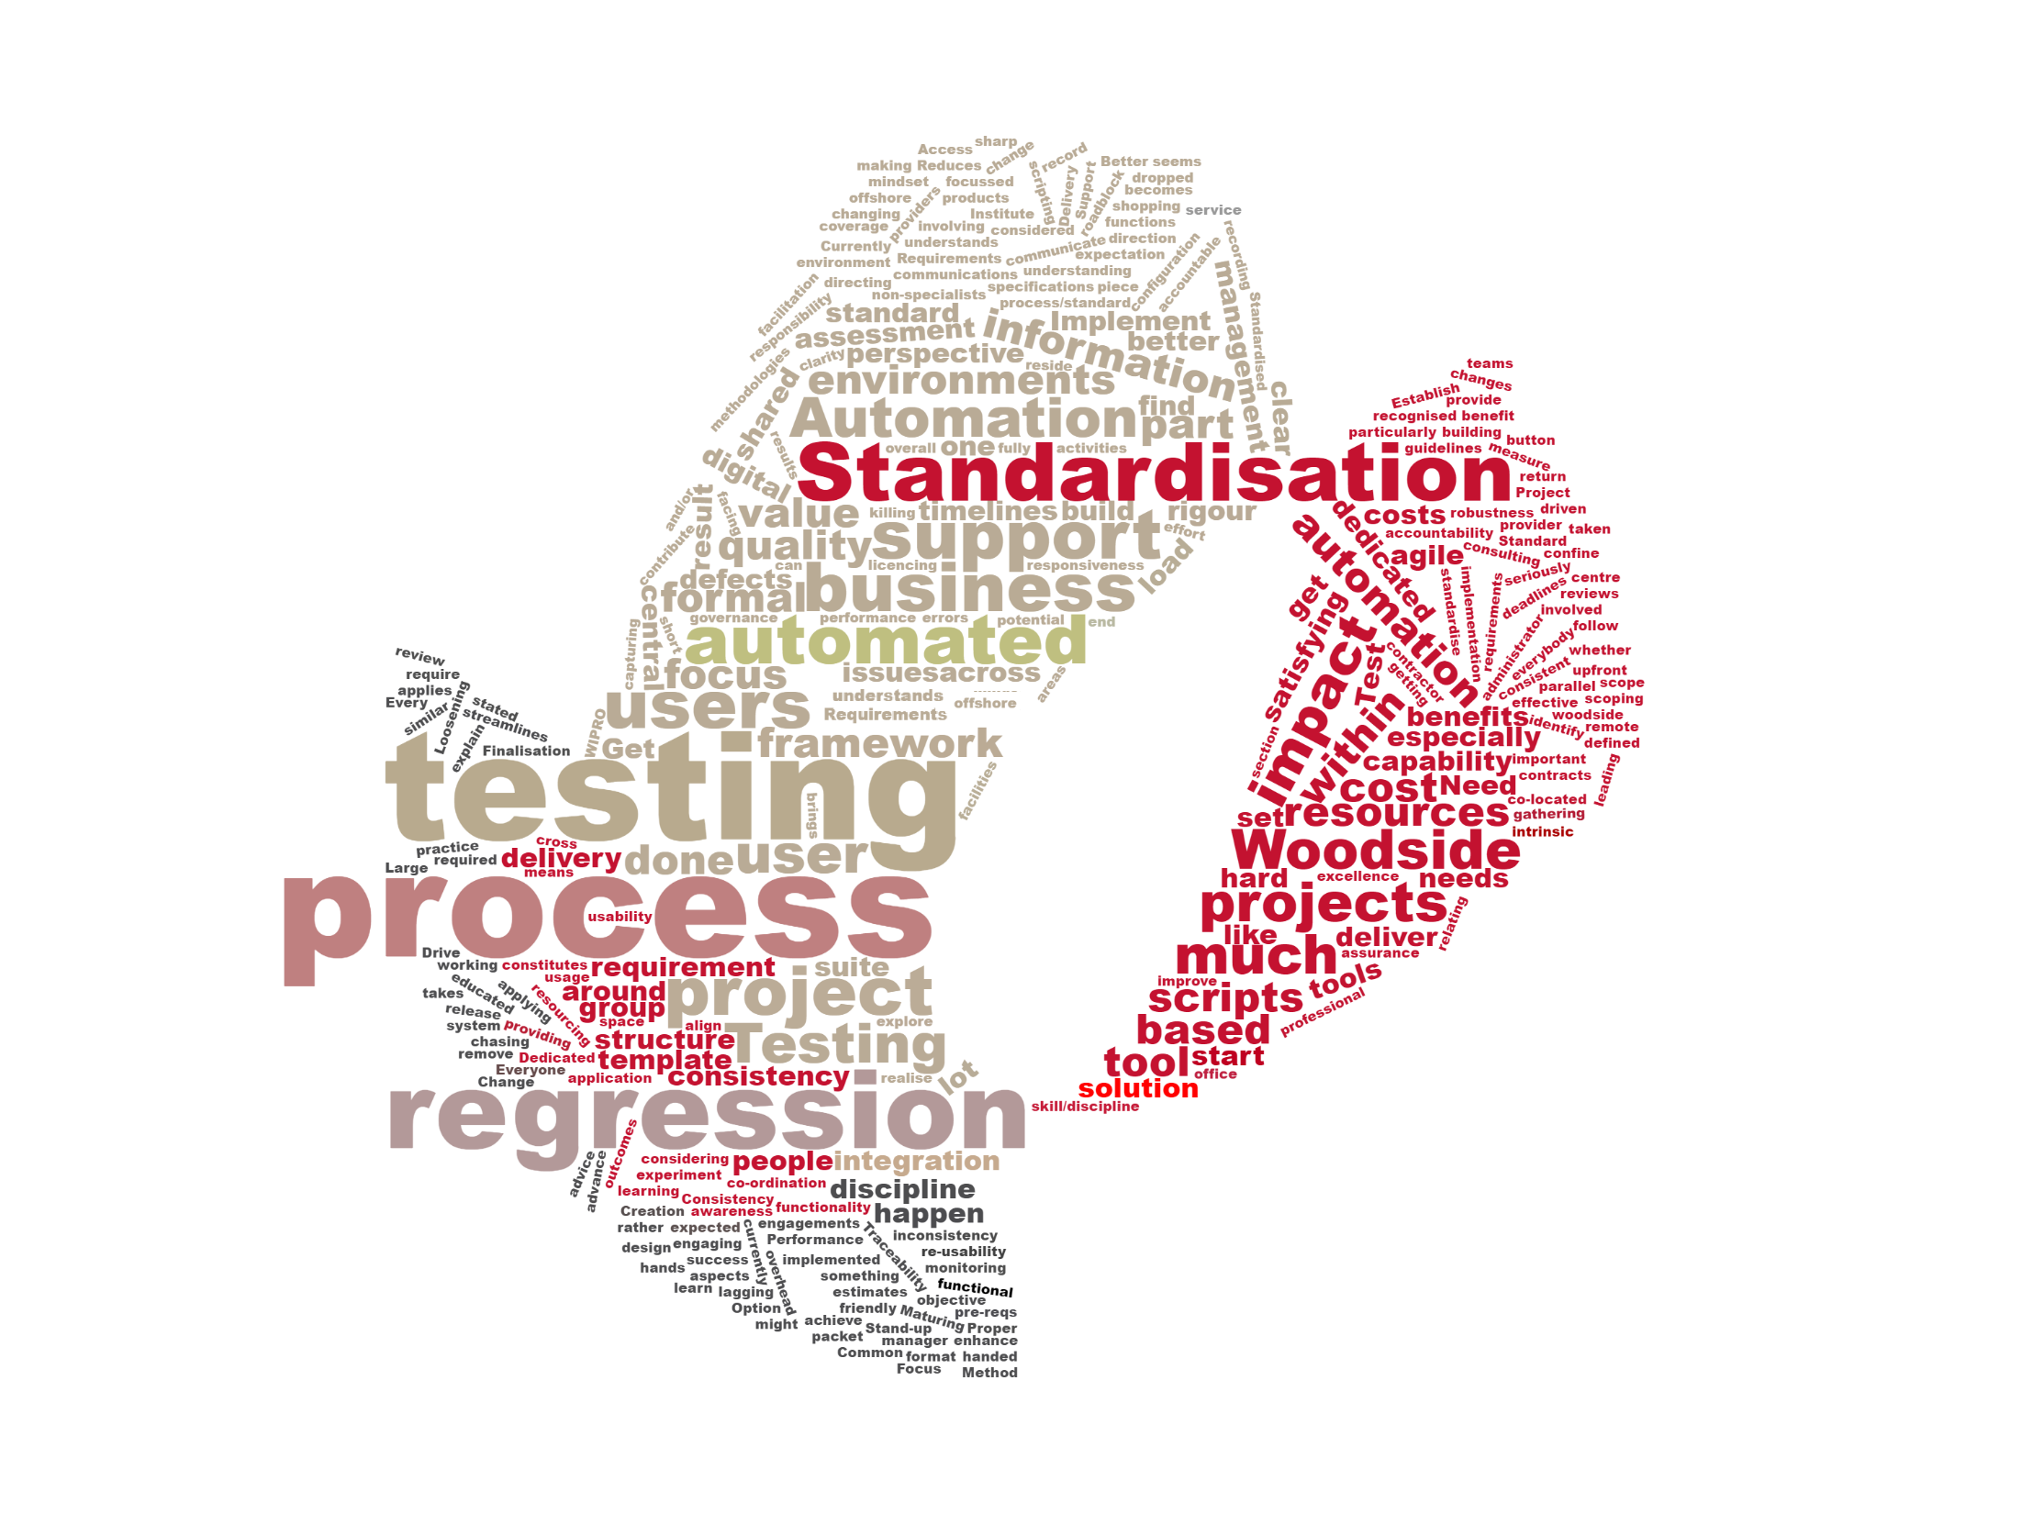
In your words

Slide 10
Reflections
On planning:
On test estimation:
“"Complete thumb suck as far as justifying the estimate goes.“”
"Testing has to fit into what time remains at the end of the project"
On regression testing:
“Regression testing in SAP puts a huge burden on the BAs and users“
“It's a pain in the arse”
On consistency:
“It’s SAP v’s everyone else”
"Some things are being over tested and some not nearly near enough"
On governance:
“Sign off process is “I’m happy” or the team is”.
"As long as I have something in writing it's good to go”
On testing:
“Everybody agrees it should be done and everyone agrees someone else should be doing it.”
“From an end user perspective, they would not perceive the testing done as adequate.”
“Management views it as a necessary evil”
On test strategy:
“Winged it”
“Projects do their own thing”

Slide 11
Key Themes
What we found
TPO Findings

Slide 12
TPO Findings
Reliance on people over process
Siloed projects with lack of cross portfolio view
Lack of centralised test practice, framework and operating model
Testing is considered a final phase rather than a continuous activity. Value of testing not realised.
No consistent traceability between test artefacts and requirements

Slide 13
TPO Findings
No consistent approach for regression testing creation and execution
No consistent approach to test estimation, planning and scope creep
No test automation framework or strategy
Inconsistent knowledge and skill base relating to testing and the test process
No consistent approach for performance and load testing

Slide 14
TPO Findings
No standard test artefacts
Inconsistent project governance and testing risk assessment approach
No common testing metrics and reporting
Undefined defect management process
Project testing assets not consistently re-used or maintained after go-live

Slide 15
Optimisation Opportunities
What to focus on
Key Recommendations
Detailed Activities

Slide 16
Optimisation Opportunities
Introduction of centralised testing champions
Siloed projects with lack of cross portfolio view
Bi-Modal test framework
Lack of centralised test practice, operating model and integration with existing change management process.
Test management process
Undefined defect management process
Inconsistent knowledge and skill base relating to testing and the test process
No standard test artefacts
No consistent approach to test estimation and planning
Inconsistent project governance based on testing risk decisions
No consistent traceability between test artefacts and requirements
Testing engaged to late in life cycle
Reliance on people over process
No centralised testing practice or knowledge
No consistent use of test management and reporting toolsets
No consistent measurement of quality throughout the product delivery lifecycle

Slide 17
Optimisation Opportunities
Test Automation and Performance model
Regression Testing Approach
Establish Continuous Improvement driven via testing metrics
No common testing metrics and reporting
No test automation framework or strategy
No consistent approach for performance and load testing
Project testing assets not re-used or maintained after go-live
No consistent approach for regression testing creation and execution
Value of testing not quantified

Slide 18
Detailed Activities
Introduction of centralised testing champions
Create Bi-Modal test framework
Establish test management process
Approach
Create competency to devolve knowledge and responsibilities to delivery teams/product owners
Establish key knowledge/training requirements for testing
Coaching other resources
Define CoE roles and responsibilities
Centralised testing service contact (cross portfolio)
Drive strategic / cultural change
Support project delivery
Establish common language of testing
Engagement of line of business representatives to understood business and operation needs
Approach
Creating set of minimum standards to support Agile and Waterfall delivery
Standard templates to avoid rework
Align to existing UCP / HOTS process
Testing against business needs and risk appetite
Define test estimation and planning model
Testing delivery responsibilities
Identify pilot projects for implementation of framework
Approach
Drive use of common Test Management tool(s)
Create defect management process
Ensure traceability from tests to business needs (requirements)
Establish minimum standards and classifications for test cases / defects
Embed testing as a process not an end-of-project phase.
Establish facility to drive performance change across Woodside and technology partners.

Slide 19
Detailed Activities
Test Automation and
Performance model
Regression Testing Approach
Establish Continuous Improvement driven via testing metrics
Approach
Guidance on when and how to Performance test based on change risk and application classification
Review and evaluation of all automation and performance plans/results produced by Woodside partners.
Establishing automation co-ordination and evaluation capabilities to ensure tooling decisions, approaches and implementations are appropriate and drive business value
Approach
Identifying, standardising and optimising key regression test suites for critical apps.
Creation of maintenance model for regression testing assets.
Where applicable, co-ordinating the implementation of automation for regression test suites.
Monitoring and reporting on the re-use, defect detection rate and efficiency of regression test suites.
Approach
Establish KPI for testing / quality
Establish common reporting framework and dash boarding
Monitor quality of deliverables across delivery lifecycle
Understand quality across portfolio and suppliers
Metrics will help drive CI process

Slide 20
Roadmap
What do next
Transition Overview
Implementation Plan
Resourcing

Slide 21

Transition Overview
6 - Establish Continuous Improvement driven via quality KPIs
COST
5 - Reporting Standardisation
Low
Medium
High
COMPLEXITTY
4 - Define and deliver test automation and performance model
Decentralised testing service capability delivered via Woodside CoE
Low
Medium
High
3 - Establish and embed Test management process and tooling (ALM/JIRA)
2 - Create and implement Bi-Modal test framework
1- Introduction of centralised TMO
Competency

Slide 22
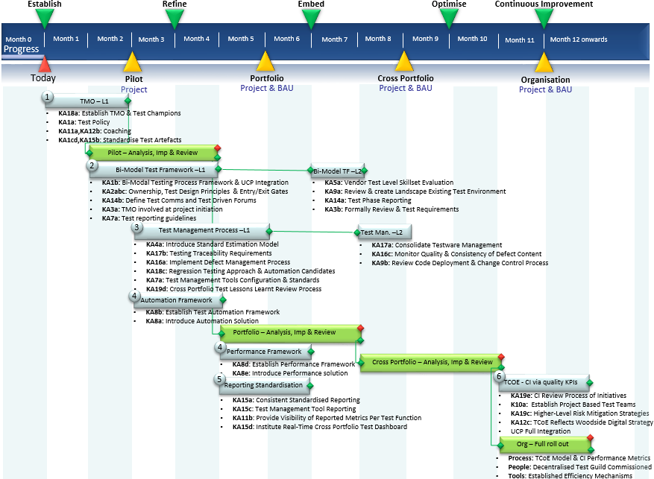

Slide 23
Your Feedback is Welcome
Jason Stannage: 0414 487 051 jstannage@planittesting.com

